Slide 1
How to enter Final Grades

Slide 2
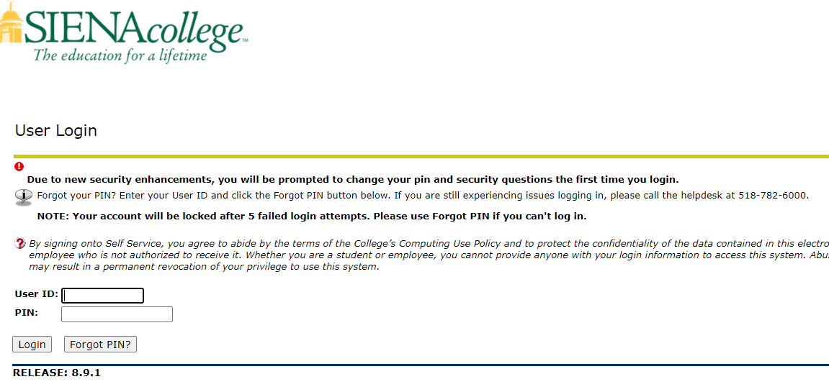
Log into Banner Self-Service: siena.edu/banner

Slide 3
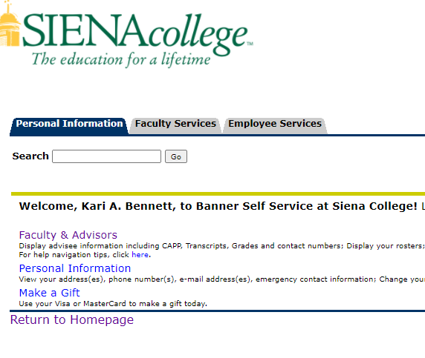
Select the Faculty Services Tab or Click on Faculty & Advisors

Slide 4
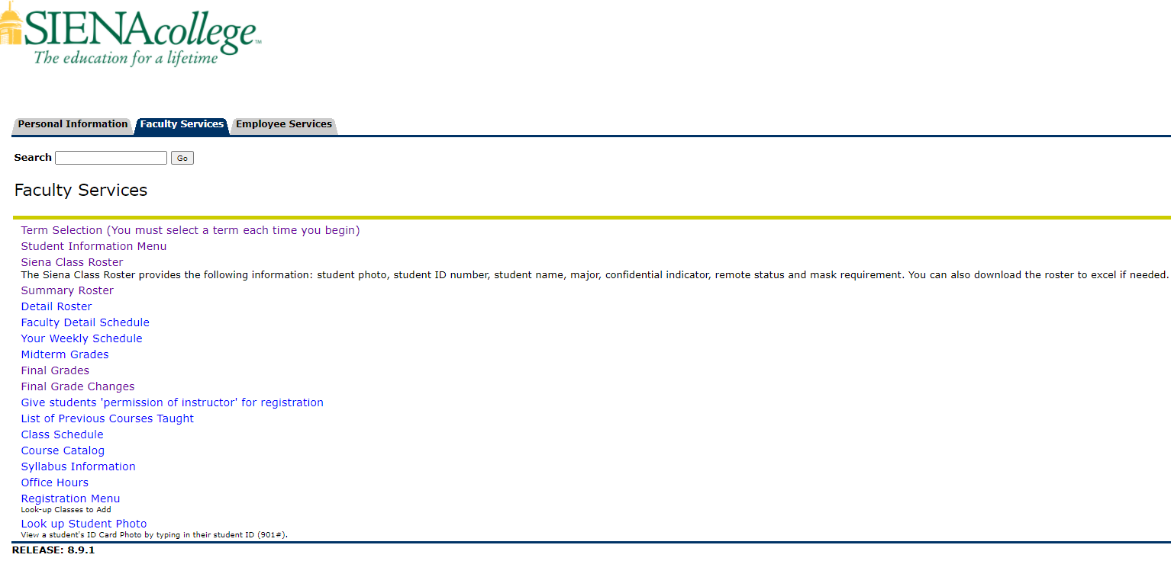
Click on the Final Grades link

Slide 5
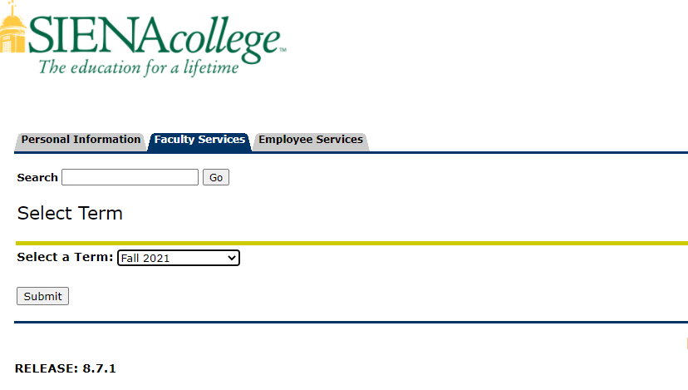
Select the term you are entering grades for

Slide 6
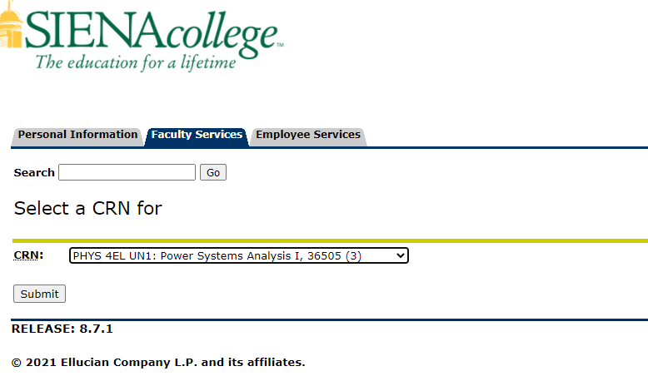
Select the course you are entering grades for

Slide 7
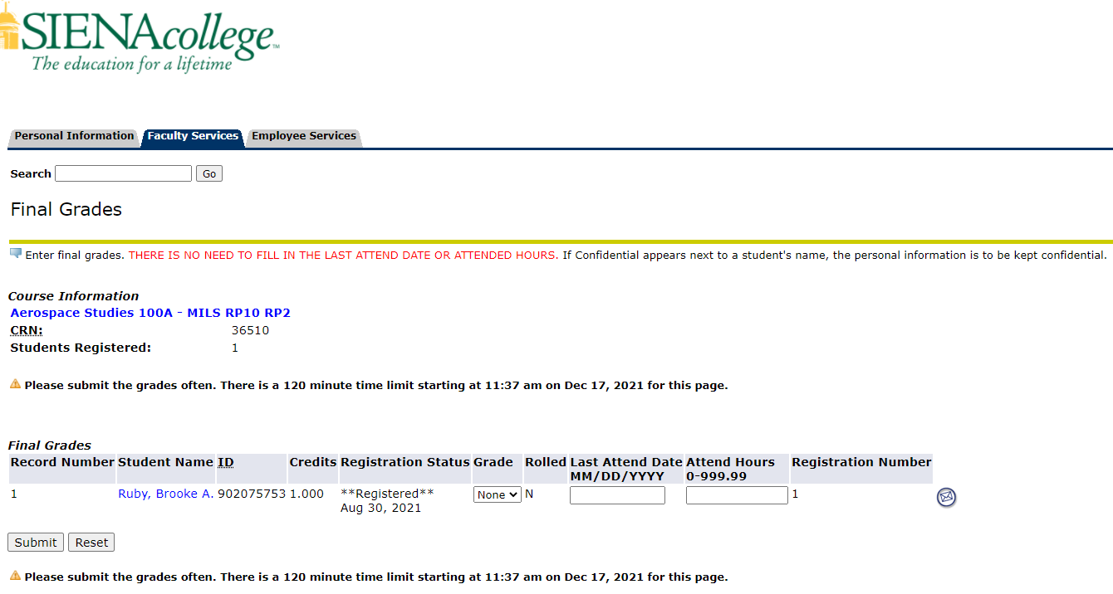
Select a grade from the drop down menu and click on it. Once you have selected the grades, please make sure you click on the Submit button.

Slide 8
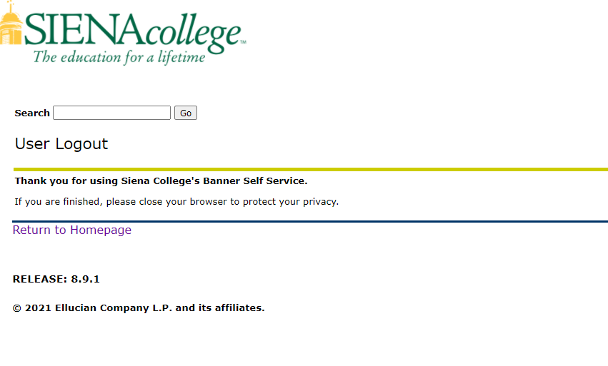
Click Exit in the upper right corner. Thank you for submitting your grades

